Slide 1

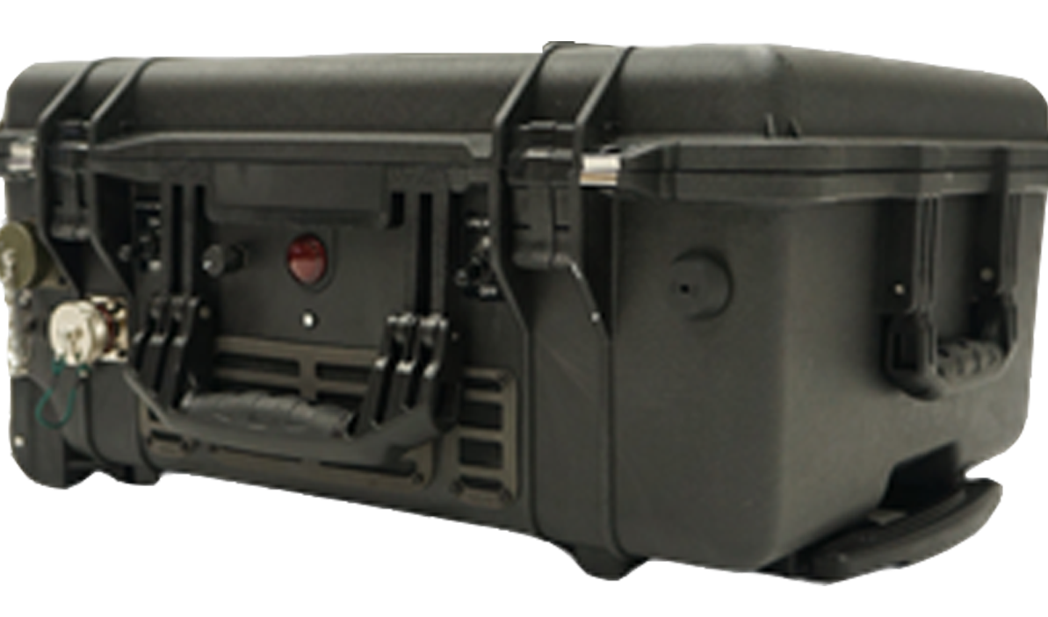
Tether Management System (TMS)
BLUE UAS and NDAA COMPLIANT | MADE IN THE USA
Tether Length | Up to 500 ft tether length
Fiber Type | One Single Mode Fiber
Fiber Connector Type | LC
Tether Management | Motorized auto-tension, static dissipation, level wind, active cooling
Dimensions | 20” x 18” x 10”
Weight | 60lbs
Input Power | 208 – 250V AC, up to 9,000 watts, 25ft cable included
Data Interface | Rugged RJ45 Ethernet IP
Recommended Generator | Single Phase, 208-250VAC
Safety Features | Power loss alarm and light, grounding rod, ethernet lightning arrestor
bd@tcomlp.com | (410) 312-2300
7115 Thomas Edison Drive| Columbia, MD 21046 | www.tcomlp.com
©2025 TCOM, L.P. | Company Proprietary and Confidential Information | All Rights Reserved

