Slide 1

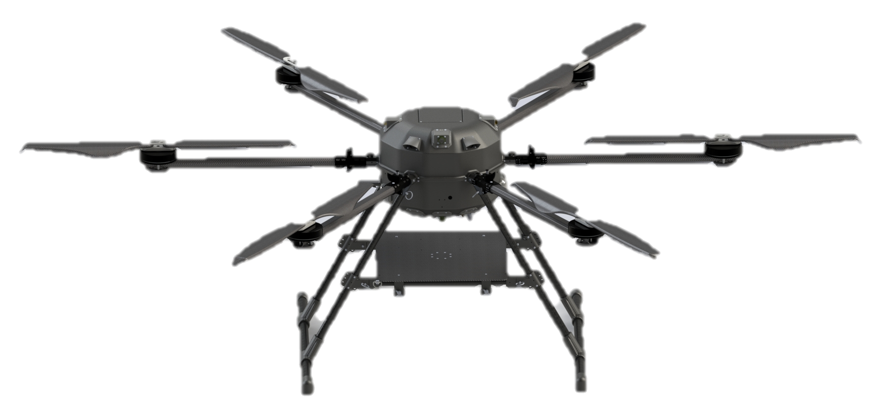
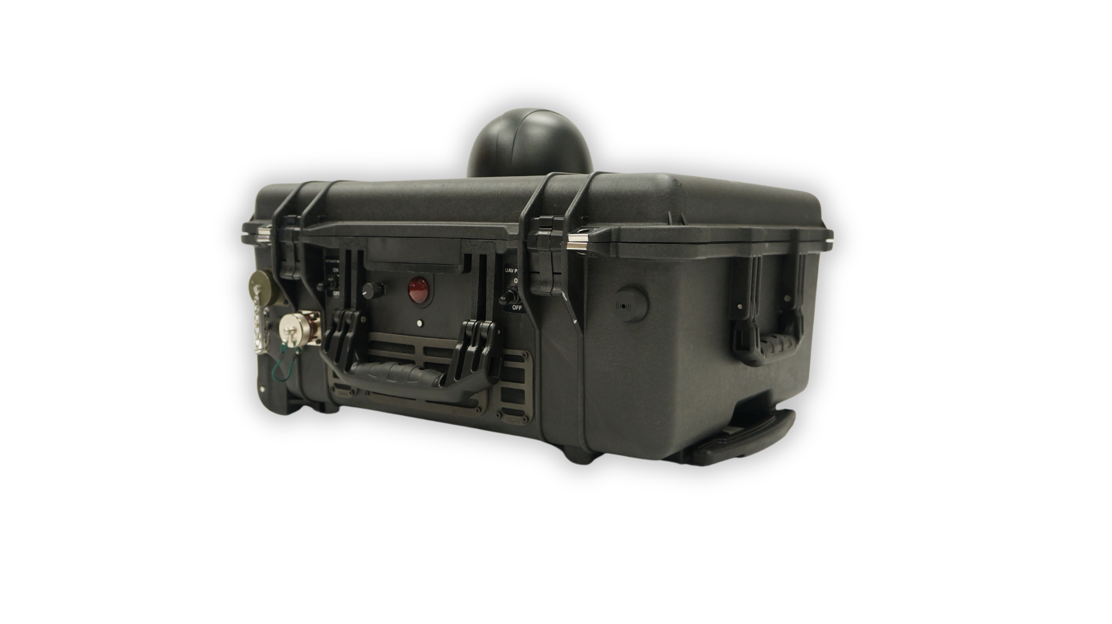
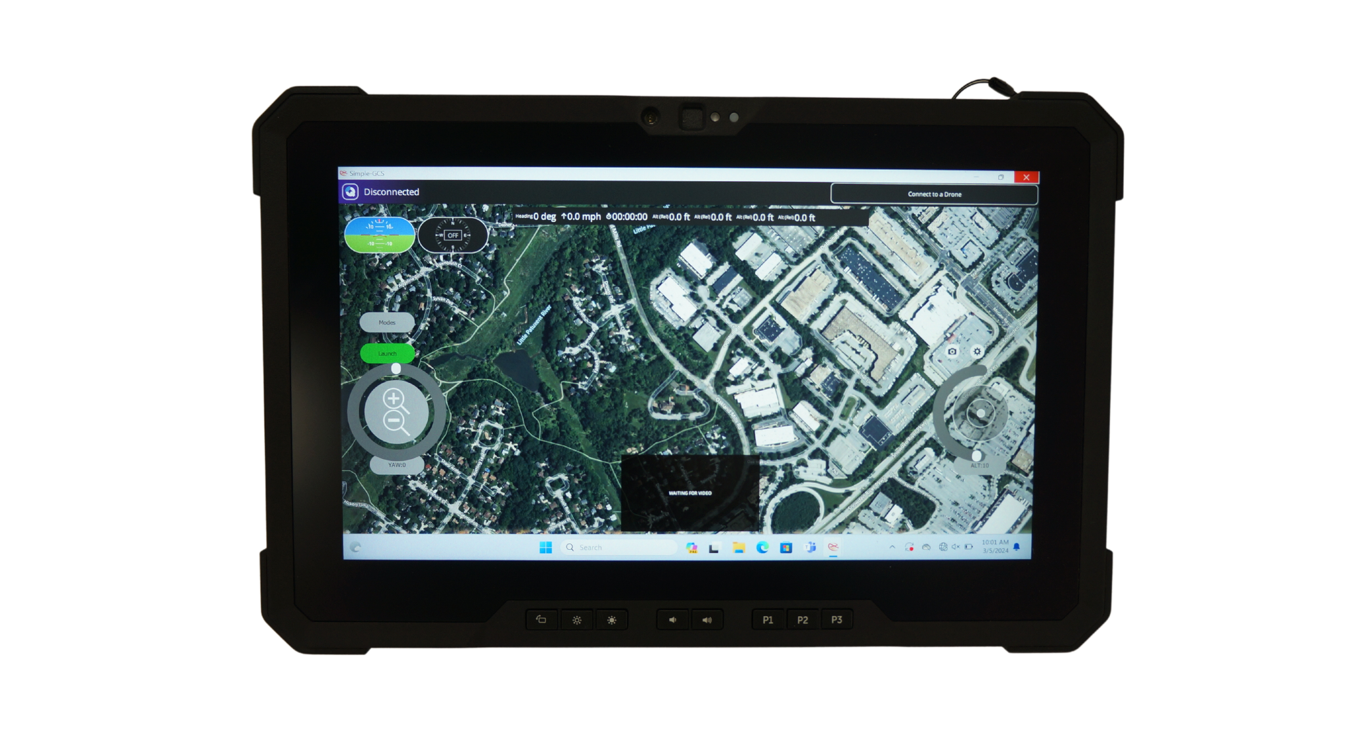
Falcon Heavy Tethered UAS
BLUE UAS and NDAA COMPLIANT | MADE IN THE USA
Continuous Flight | Up to 30 days
UAS Max Takeoff Weight | ~85 lbs. with max payload
Payload Weight Capacity | Up to 30 lbs.
Weather Rating | IP54 (rainy dusty environment)
Wind tolerance | Up to 25 mph sustained, 35 mph gust
UAV Frame Dimensions | 1900 mm x 900 mm
Landing Gear | RF Transparent Kevlar
Safety batteries | Emergency landing from up to 400ft
Mobility | Launch and land on the move up to 27 mph
Command and Control | Wired C2 over IP (GbE): optional wireless backup, optional fiber optic
Payloads | Application dependent. Examples: EO/IR, comms, RADAR, SIGINT, EW
Payload Networking | IP switch; Network Interface: RJ45
Payload Power Supply | 200 Watts (or custom) at various voltages (5, 12, 24, 50V DC)
Tether Length | Up to 400 ft
Tether Management | Motorized auto-tension, static dissipation, level wind, active cooling
Input Power | 208-250VAC 30-amp NEMA L-14 plug or selectable
Recommended Generator | Single Phase, 208-250VAC, 10,000 watts (max continuous)
Safety Features | Backup tether comms, power loss alarm and light, grounding rod, optional aerial strobe, ethernet lightning arrestor, OVERWATCH™ advanced autopilot
BD@tcomlp.com | (410) 312-2300
7115 Thomas Edison Drive| Columbia, MD 21046 | www.tcomlp.com
©2024 TCOM, L.P. | Company Proprietary and Confidential Information | All Rights Reserved

